Slide 1
Oreilly Architectural Katas Mobility corp. - Solution
Gayathri Sankara Subramanian
Karthik Balasubramanian
Lokkeshwaran J
Shanmugam Kothandan

Slide 2
Agenda
Introduction
Problem statement and Use-cases
Proposed architecture overview
Detailed component view
AI ML integrations
End-user app. Design
Admin UI Design
Platform security consideration
AI security integration
Privacy and GDPR compliance
Cloud and infra. view.
Design considerations
Work effort estimation and planning
Assumptions

Slide 3
Introduction
Mobility corp. enables seamless, secure vehicle sharing and rental, powered by robust technology and advanced AI capabilities.
Solution detailed in this presentation targets real-time tracking, predictive allocation of vehicle for rental, value added services to customers with gamifications and discounts for increasing retention, at the same time ensuring full regulatory and security compliance.

Slide 4
Problem statement and use-cases
User and vehicle on-boarding – KYC and context management
Rental workflow with vehicle availability and constraints
Payment integration
Audit tracking
Vehicle location tracking
Fine mechanism – for misuse and time violation
Parking slot management
Vehicle Battery pack management
Trip management – with AI assisted validations
AI for vehicle drive range, customer demand prediction and customer support chatbot
Compliance – GDPR, Disaster recovery and security.

Slide 5



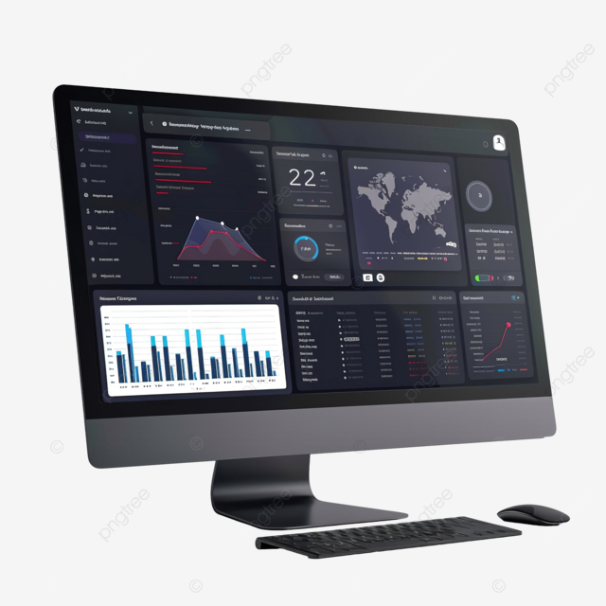




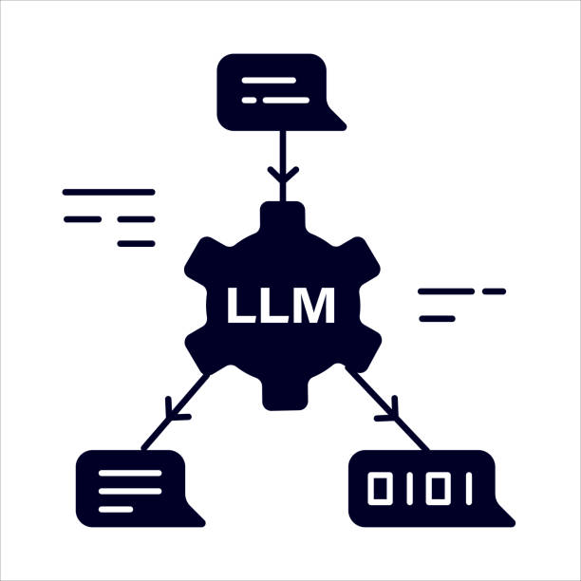




Proposed architecture overview
User onboard service
Vehicle onboard service
End-users
Rental service
Relational Database
End-user mobile App
Audit service
Vehicle location service
Document Database
Parking service
Admin user
DNS service
Load balancer service
API gateway
Trip management service
Admin UI
Battery service
AI services
AI chatbot backend
Firewall
Payment service
3rd party integrations

Slide 6
Detailed component view
Feature/use-case | Key Architectural component | Remarks
Vehicle and user on-boarding | Admin UI, End-user mobile app, User onboard service, vehicle onboard service, relational database, API gateway, Load balancer, DNS | The on-board services expose APIs to on-board users and vehicles, and the onboarded users and vehicles are managed in a relational database for easy mapping and relationship maintenance
Rental workflow | End-user mobile app , Rental service, API gateway, load balancer, relational and document database, AI services, location service | Time based, vehicle class based and location aware, AI integrated logic for optimized rental management of vehicles in inventory.
Payment workflow | Payment service, 3rd party integrations, API gateway, load balancer, document database | PCI DSS integration, maintaining transaction logs.
Trip, battery and Parking slot management workflow | Trip management service, battery service, Parking service, API gateway, load balancer, location service, AI services, audit service | Automated and optimized vehicle to user mapping, trip closure mechanism with intelligent image-processing based verification based on photo proof, Optimized vehicle battery swapping based on AI based predictions.
Fines , continuous monitoring and audit workflow | Audit service, location service, parking service, rental service and admin UI | Advanced continuous monitoring and tracking of vehicle , to prevent misuse and breach of contract. Automated fining mechanism for any incidents identified and logged with evidences with on need basis admin intervention.
Location tracking workflow | Vehicle, Api gateway, load balancer, document database, admin UI | Continuous tracking and auditing of each vehicle and maintaining location trace with timestamp
Application workflow | End-user mobile app , Admin UI | Provides a frontend user interface for end-user and administrator offering all functionalities of the solution.

Slide 7
AI – ML integration
Electric vehicle optimized selection for customer destination based on range prediction and available state of charge
Customer demand forecasting based on regional and web-search identified events, festivals and user-base calendar integration.
Optimized Battery pack replacement decision based on customer demand.
Image processing driven intelligent and automated trip closure mechanism integrated with fining mechanism for deviations.
Frequent usage and referral-based end-customer credits to promote regular usage.
Fraud detection based on usage patterns.
An intelligent Gen AI driven chatbot solution for end-customer integrated In mobile App which has end-to-end doubt clearance, information fetching and rental workflow capabilities

Slide 8
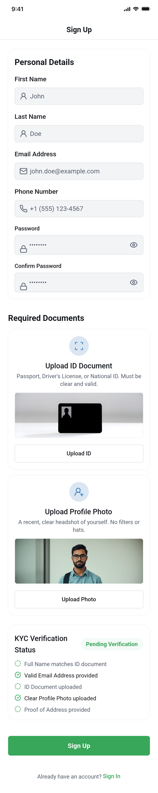
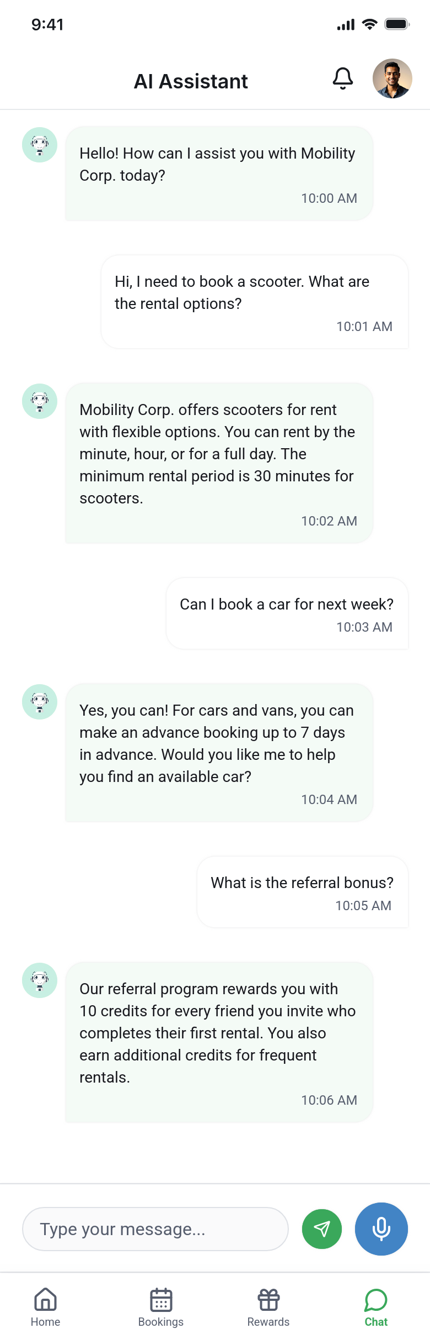
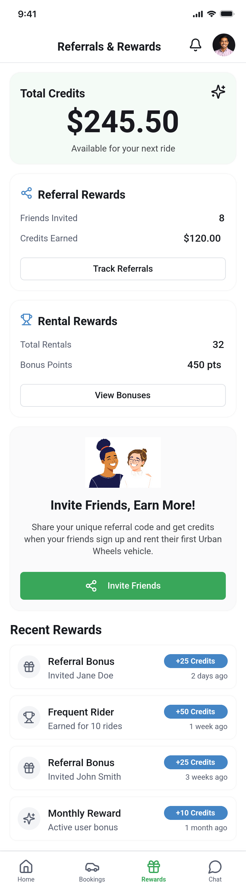
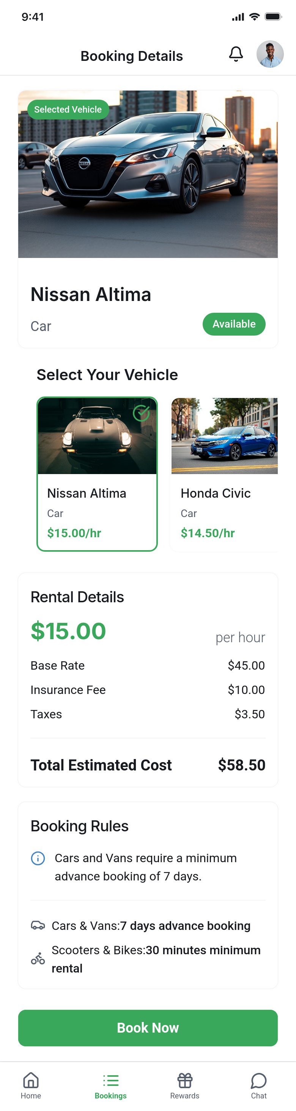
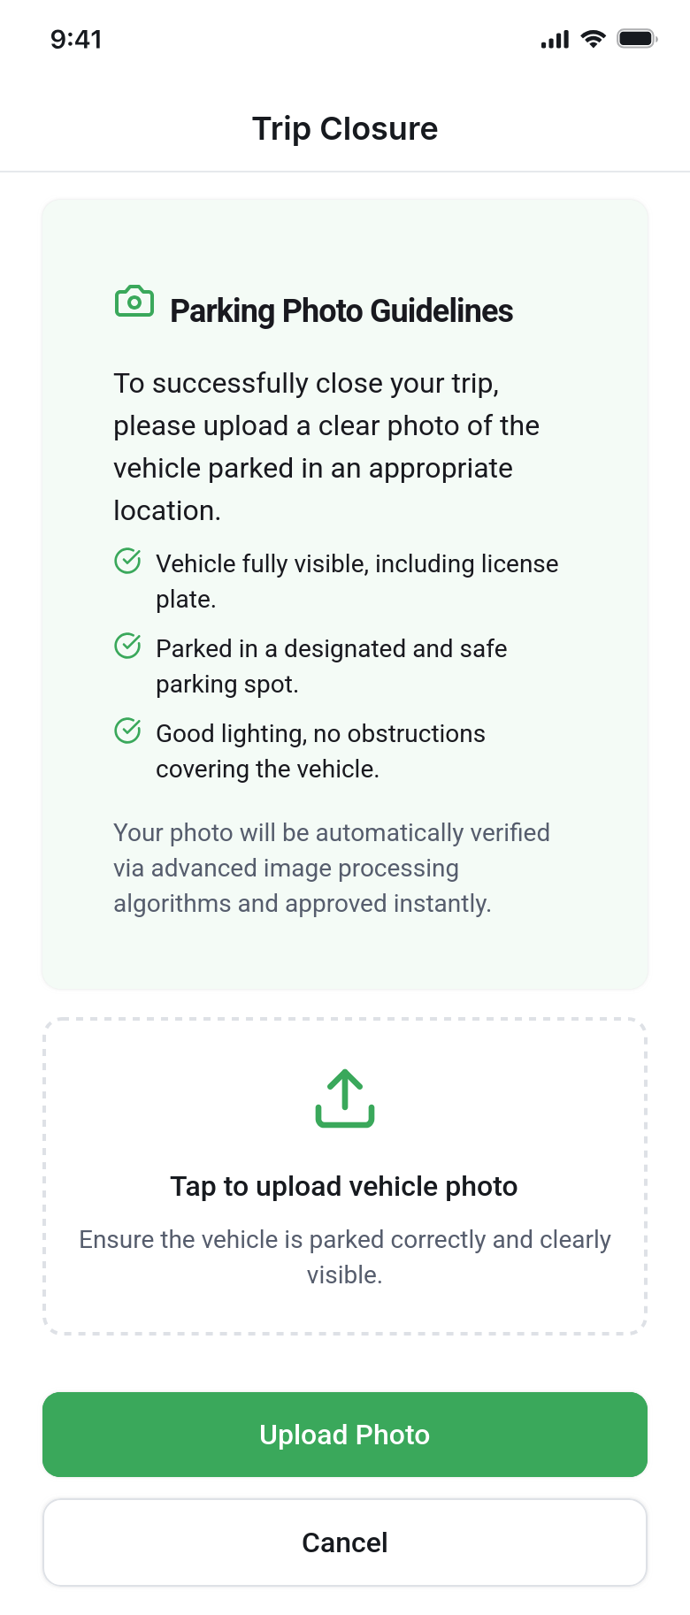
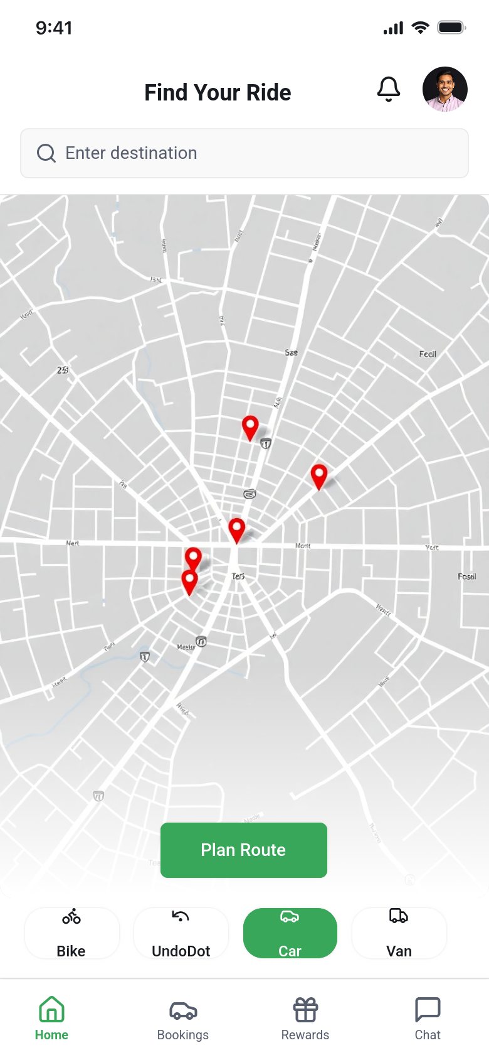

End-user App design

Slide 9
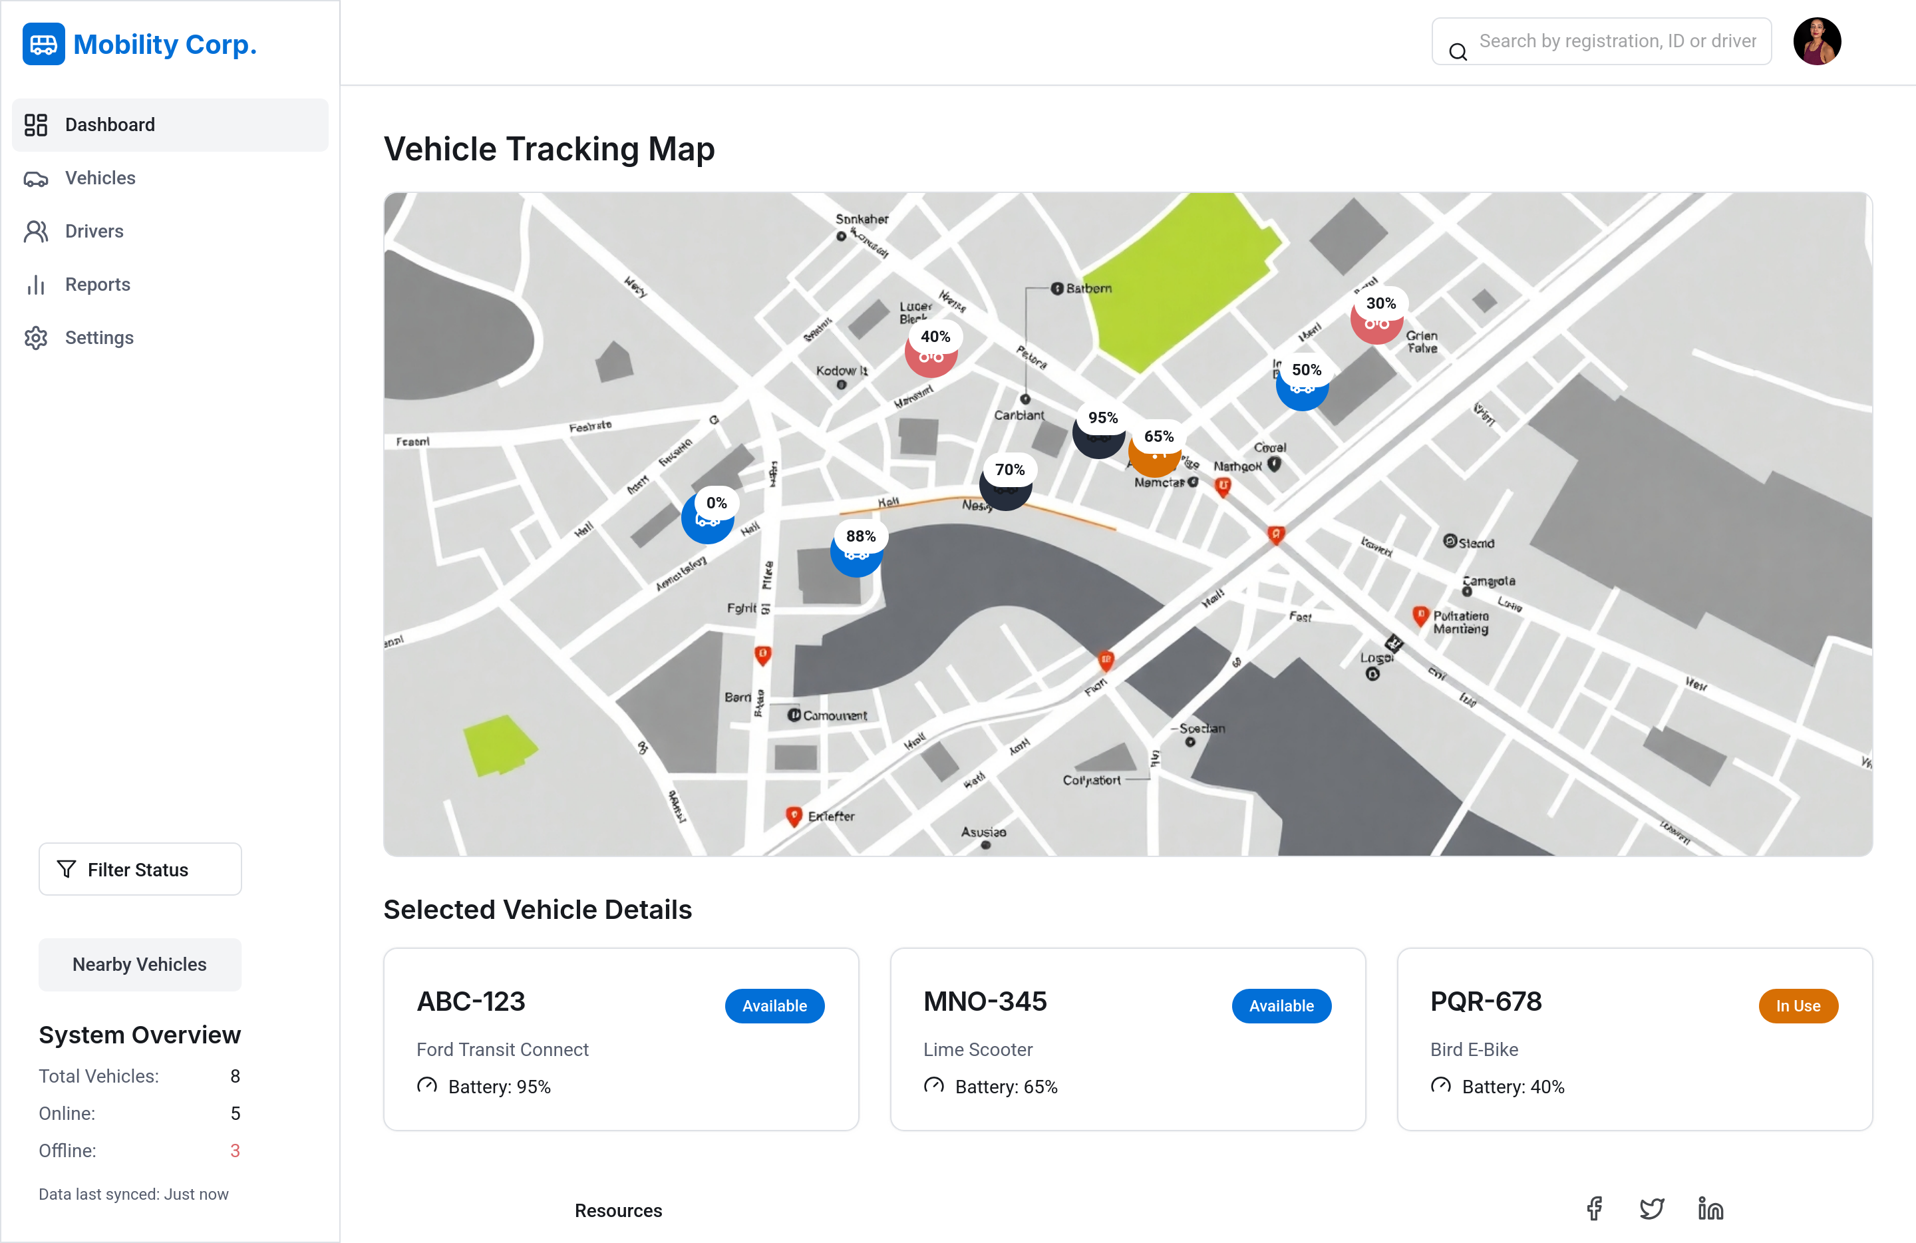
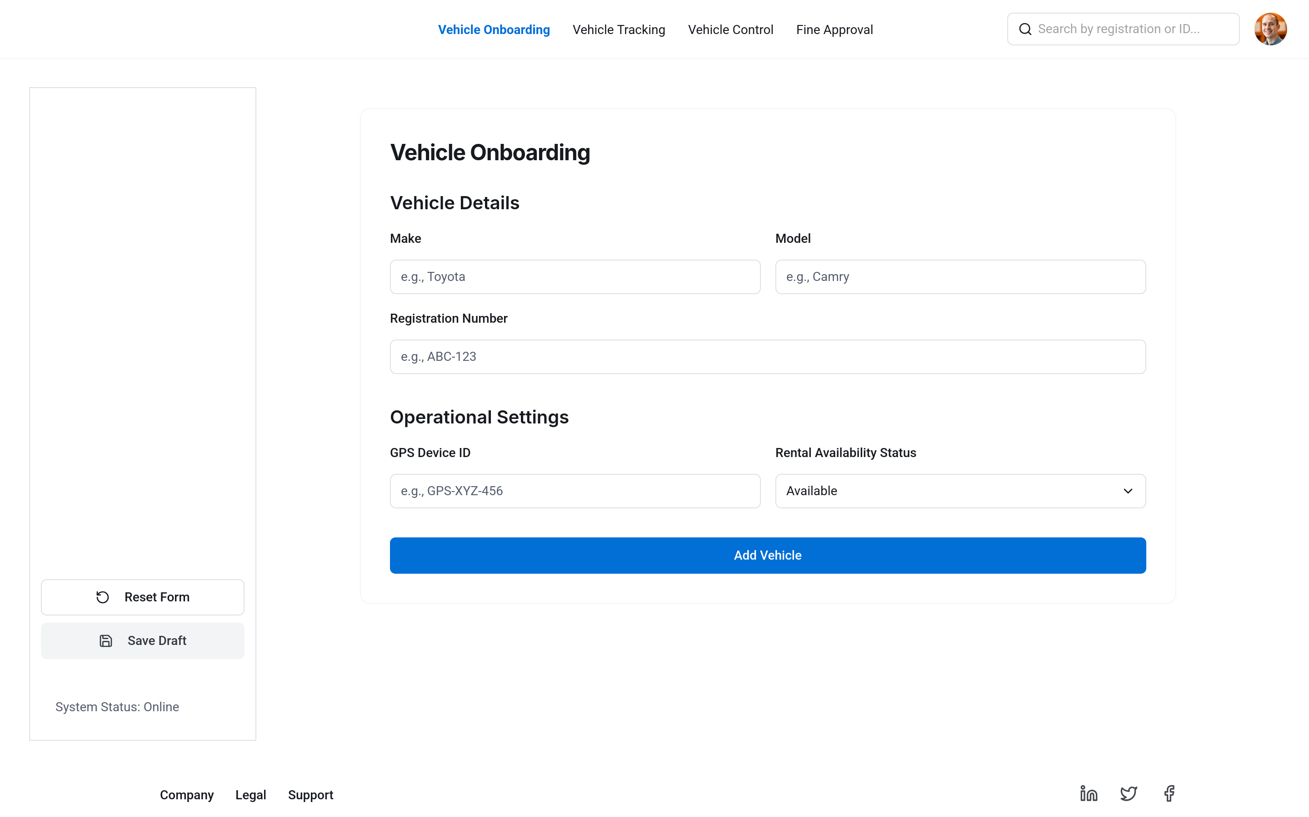
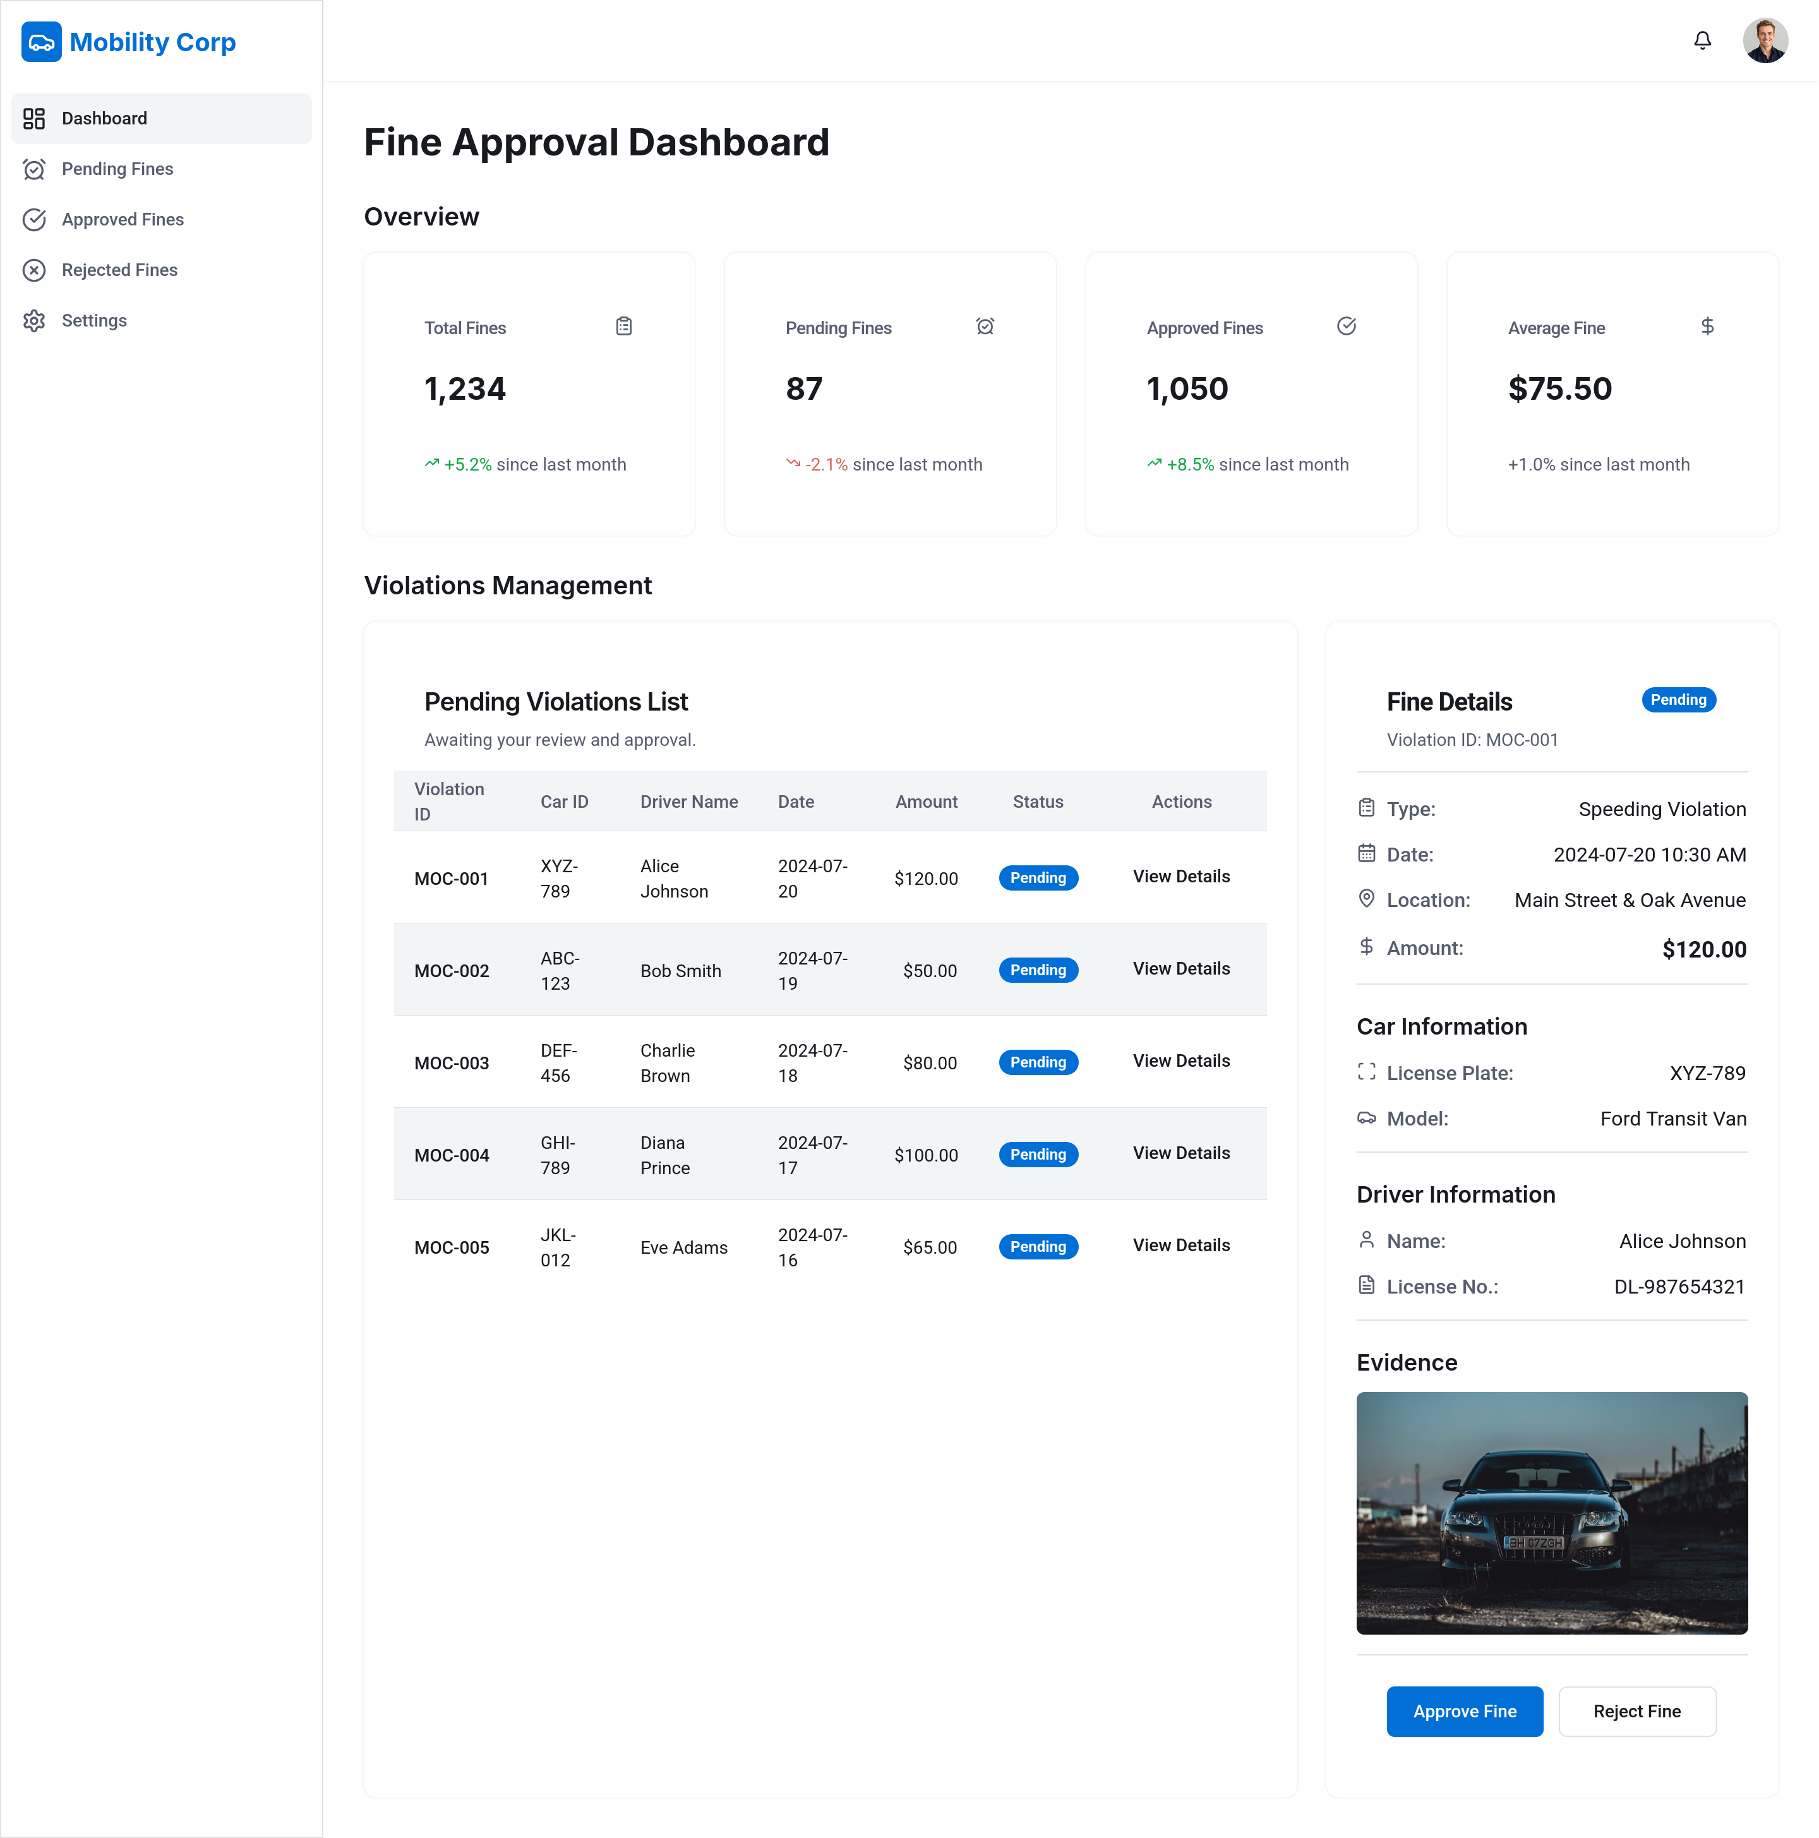
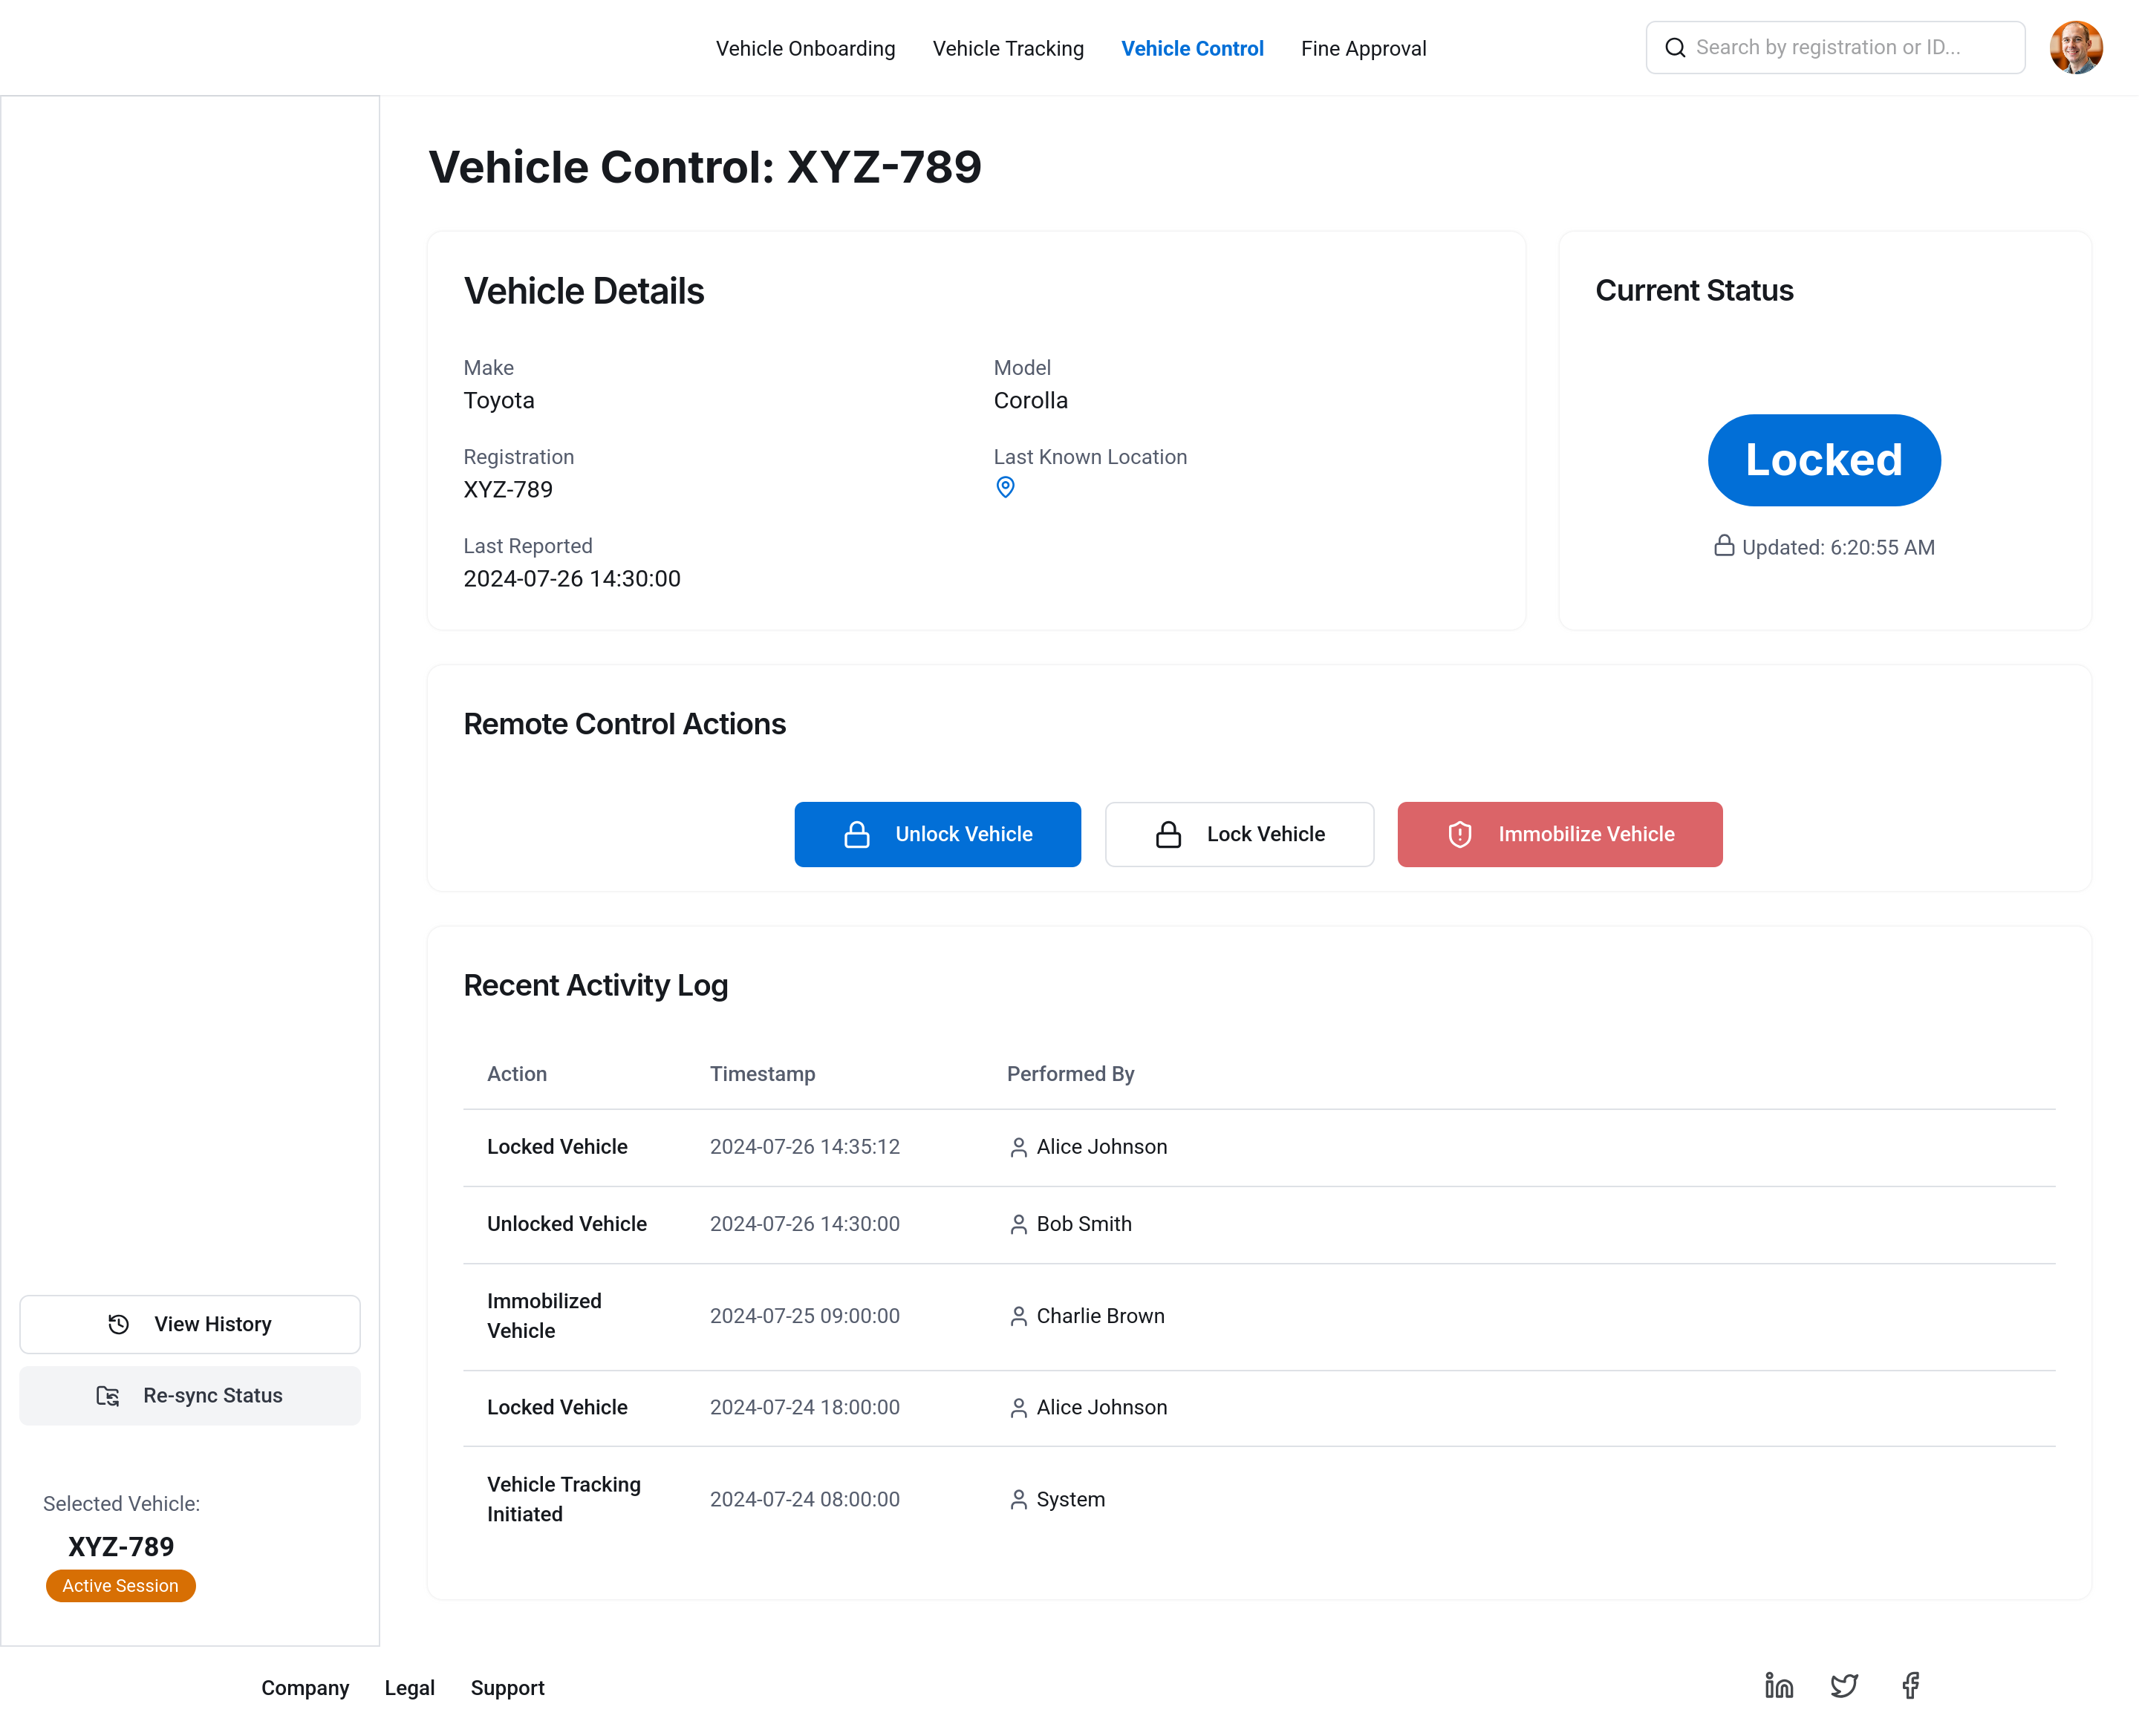
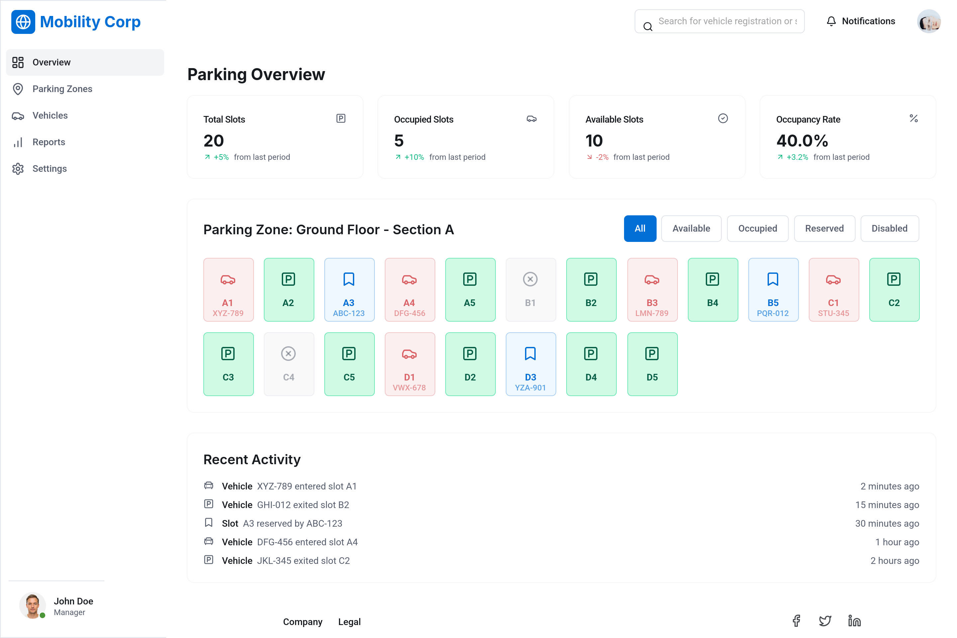
Admin UI design

Slide 10
Platform Security consideration
Zero-Trust Security Architecture: Adopts zero-trust principles and enforces strict IAM policies to ensure that only authenticated and authorized users and services can access system resources.
Network Segmentation: Implements segmented network zones to contain lateral movement of threats and minimize the impact of potential breaches.
Defense-in-Depth Strategy: Applies multiple layers of security controls—including firewalls, WAFs, security groups, antivirus, and system hardening—to protect the platform and data against cyberattacks.
Data Encryption & Key Management: Ensures all data in transit and at rest is encrypted using customer-managed keys, safeguarding against unauthorized access and maintaining data integrity.
Security Incident Monitoring & Alerts: Utilizes SIEM solution such as anomaly detection and real-time monitoring systems to identify suspicious activity and enable rapid incident response.
Cloud Security Posture & Vulnerability Management: Continuously monitors for misconfigurations and vulnerabilities across IaaS and PaaS environments, enforcing compliance and reducing risk.
Shift-Left Security Approach: Integrates security early in the development lifecycle, embedding controls during design and coding phases rather than post-deployment.
Risk Assessment: Evaluates potential threats across all components of the MobilityCorp platform and its cloud architecture to proactively mitigate risks.

Slide 11
AI Security Integration
AI Guardrails
1
Protects LLMs from adversarial threats such as prompt injection and filtering both inbound and outbound prompts, ensuring models operate within defined boundaries.
Least Privilege Principle
2
Apply strict access controls within AI systems to ensure components and users operate with only the permissions necessary for their roles.
Secure MLOps & Supply Chain Protection
3
Implements security in the MLOps pipeline to detect and mitigate vulnerabilities, including those from third-party libraries and dependencies.
Privacy-Preserving Techniques:
4
Uses methods like pseudonymization and anonymization to protect individual identities and prevent reverse engineering of personal data.
AI Risk Management
5
Identifies and addresses risks specific to AI systems, including privacy breaches, bias, misuse, and adversarial attacks, ensuring responsible AI deployment.

Slide 12
Privacy and GDPR Compliance
User Data Rights Enablement
1
The platform empowers users to access, correct, and delete their personal data in accordance with GDPR, ensuring a privacy-by-design approach and full regulatory compliance.
Data Minimization & Purpose Limitation
2
Personal data collection is strictly limited to what is essential for delivering the MobilityCorp solution, avoiding unnecessary data retention.
Consent & Transparency
3
Clear and transparent consent mechanisms allow users to opt-in to data sharing, with full visibility into how their information is used and processed.
Support for Data Subject Rights
4
The Privacy Policy provides explicit guidance on how users can exercise their GDPR rights, including contact points for submitting requests.
Privacy Risk Management
5
A Data Privacy Impact Assessment (DPIA) is conducted to identify and mitigate risks associated with the collection, processing, and storage of personal data within the platform.

Slide 13
Design considerations
The design ensures modular feature specific microservice architecture
Each microservice is independently scalable to handle load for each of the feature
Databases are enabled with redundancy and daily backup to prevent data-loss
Services are deployed across multiple availability zones and over the nearest cloud datacenter to offer best network latencies.
Leverage cloud managed services where applicable with usage- based cost to prevent infra. Cost on pre-provisioned unused capacity.
Machine learning and Optical character recognition(OCR) shall be used for intelligent validation of correctness of parking slot during trip closure.

Slide 14
Thank you

